Slide 1
Moving Ahead with Demand Response in the Wake of the Supreme Court Decision
Kleinman Center for Energy Policy, University of Pennsylvania
March 30th, 2016
Pete Langbein
Notes:
This panel focuses on the recent resounding 6-2 decision by the Supreme Court to overturn the Court of Appeals, and uphold FERC's authority to include demand response in wholesale markets. This decision is cause for reflection: Will it mean a return to the status quo, or will it unleash a new and more intensive wave of demand response activity that had heretofore been frozen by the uncertainty surrounding this case? Conversely, how will this ruling affect price-responsive demand and other demand response opportunities and initiatives that might have been focused on retail had the Supreme Court decision gone the other way? Finally, how will PJM's new Capacity Performance rules and the design of capacity, energy, and other wholesale markets more broadly, encourage or thwart fuller demand response integration?

Slide 2
Demand Response and Energy Efficiency Opportunities in PJM Wholesale Market
Wholesale Service | Demand Side Response | Energy Efficiency | Price Responsive Demand
Capacity | Yes | Yes | yes
Energy | Yes
Day Ahead Scheduling Reserves (30 min) | Yes
Synchronized Reserves (10 min) | Yes
Regulation | Yes
Load Management
Economic resource
Supreme Court ruling leaves all existing PJM rules in place
Notes:
Load Management – Capacity resource that is required to respond when dispatch to ensure reliability of the system. No response = penalties
Economic DR resource – may participate when economic to participate in the market (for specific hour). Resource may or may not be available hour by hour based on their availability and economics

Slide 3
Federal vs State jurisdiction (FERC Order 719a)
Small EDC (<=4 million Mwh)
Opt In – DR may only participate if RERRA has order, ordinance or resolution that permits.
Large EDC (>4 million Mwh)
Opt Out – All customers may participate as DR unless RERRA has order, ordinance or resolution that does not permit.
RERRA = Retail Electric Relevant Regulatory Authority
Public Utility Commission, Muni Town Council, Coop Board of Trustees

Slide 4
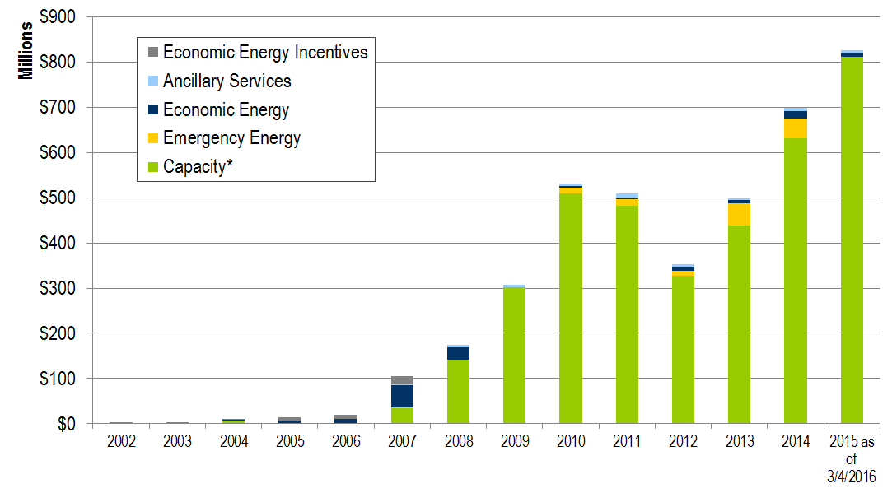
PJM Estimated Revenue for DR in PJM wholesale markets
1) Ancillary Services = Day Ahead Scheduling Reserves + Synchronized Reserves + Regulation
2) Emergency Energy = energy revenue received from Load Management event
3) Economic Energy Incentive = LMP – G&T up to FERC specific cap through 2007.
*Capacity Net Revenue inclusive of Capacity Credits and Charges

Slide 5
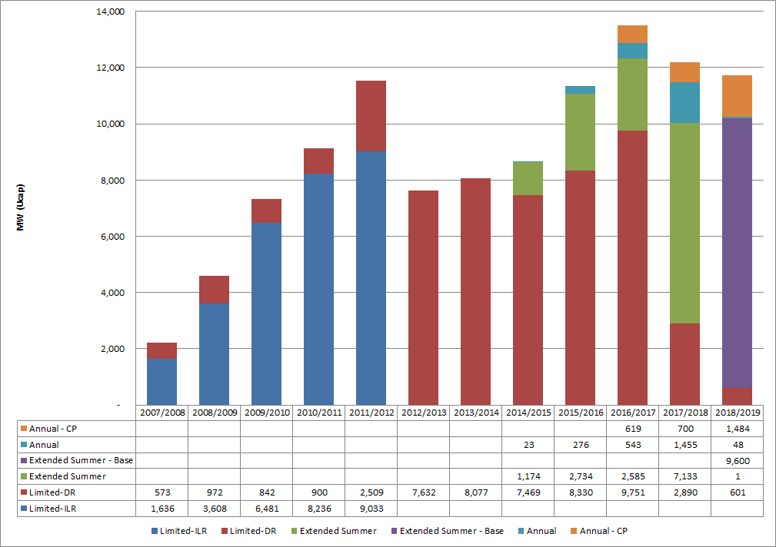
Historic and future expected DR Capacity by Delivery Year
Limited:
10 event June - Sept
Extended Summer:
unlimited events May – Oct or June - Sept
Annual:
unlimited events year round

Slide 6
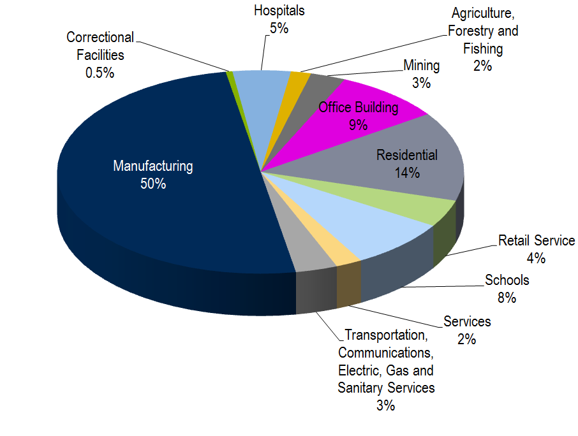
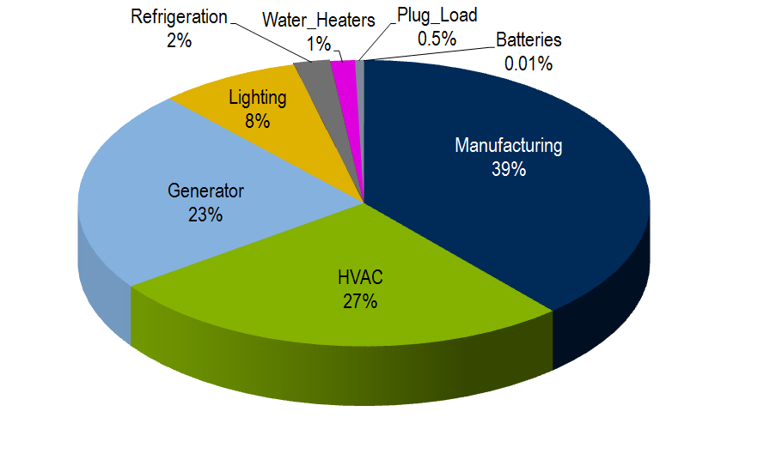
Source of DR capacity capability business sector and end use type
DR Capacity (‘15/’16)
~11,000 MW
(PJM total = 180,000 MW)

Slide 7
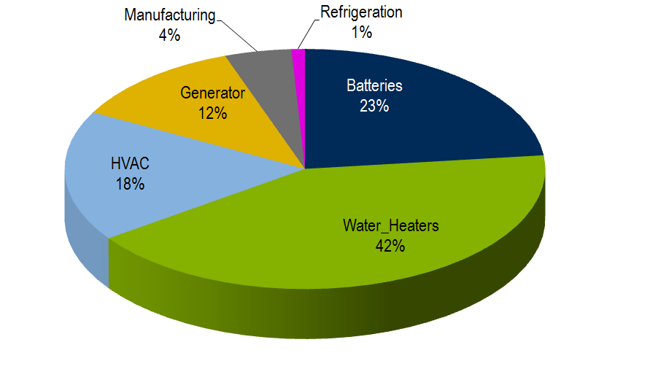
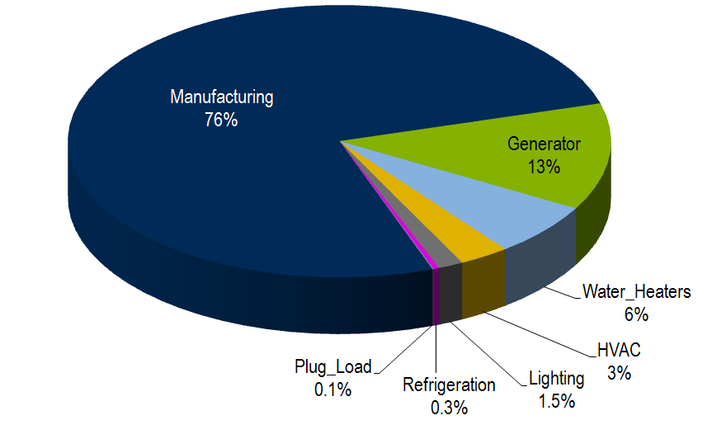
Source of DR Synchronized Reserve and Regulation participation by end use type
DR Regulation 5 MW hourly average commitment
(PJM total 700 MW onpeak, 525 MW offpeak)
DR SR 100 MW hourly average commitment
(PJM total 1,450)

Slide 8
Capacity Market transition toward Capacity Performance (“CP”) annual requirement
Now through 19/20 DY
20/21 DY and future
Annual & Summer Products
Annual (CP) Product Only
Make capacity more reliable and comparable across all resources

Slide 9
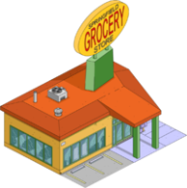
Capacity Performance …ability to aggregate to meet annual requirement
CP resource
DR
Grocery Store
Factory
Intermittent
(Wind)
Environmental Limited Generation
Energy
Efficiency
Home
Resource Aggregation
DR customer Aggregation

